Slide 1


Slide 2







2020 Virtual Tradeshow
Experience

Slide 3
Why Virtual Shows Fail
Why KBIS Virtual Succeeds
No focus on content
Sessions that Sizzle!
Packed with Content & Education
Few ways to connect
Forums, Roundtables, Coaching
Social Networking, Messaging
Not enough leads
Get attendees into the booth and deliver the lead
Not enough ways to do business
Meetings, Demos, New Product, Calls to Action

Slide 4



We Built It....They Will Come
15,000 Attendees in 2020
Compare Products Meet with Brands
See the Latest Designs
Meet with You!
Learn
Leading Thinkers
CEU Credits
Interactive Labs
Engage with Peers
Roundtables
Social Events
Forums
Architects, Builders, Cabinet Shops, Consultants, Dealers, Decorative Plumbing & Hardware Professionals, Designers, Distributors, Fabricators, Home Centers, Independent Manufacturers’ Reps, Installers and Remodelers.

Slide 5
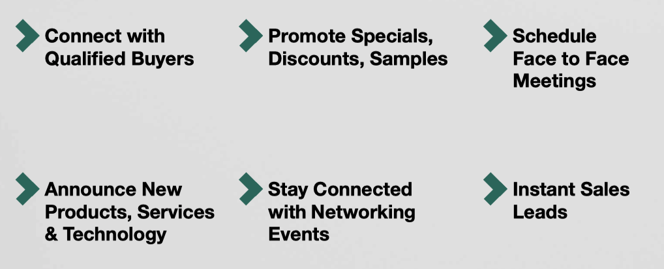
What’s in it for the Exhibitor?
15,000 Attendees in 2020

Slide 6
The Virtual Booth
Capture Leads, Create Calls to Action, Showcase Product

Slide 7



Attendees Find You
Search, Directories, Promotion
Search by Name, Keyword, Product Category
Preshow, During and Post Show Promotion
Virtual Swag, New Product, In-Booth Session Directories

Slide 8




Generate Sales Leads
Capture Attendee Contact Information
Virtual Badge Swipe
Delivers Attendee Contact Info
Attendees take action
Your team gets an email
Attendee contact info
Report with attendee detail
Get the Catalog
Virtual Swag
Book a Meeting
Attend a Demo

Slide 9
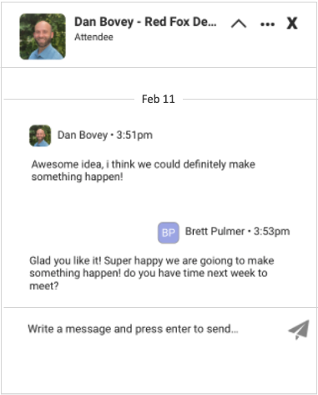
Interact & Message
In Booth Now, Chat, Message
You see who is in the booth
Chat 1 : 1 with attendees
Attendee can message the booth
Message center holds all chats and messages

Slide 10
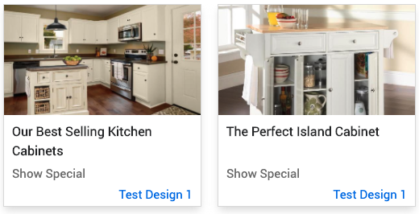
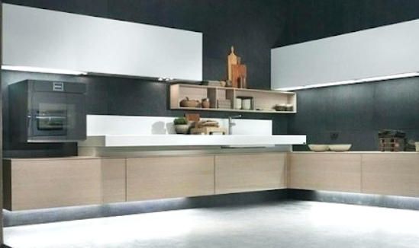
Showcase Your Products
Add Product Content, Videos, In-Booth Demo
Upload PDFs, Videos, Product Catalogs, Pricing
Embed video on the booth homepage
Hold in-booth sessions to demo products
Feature new products in booth and site directories

Slide 11
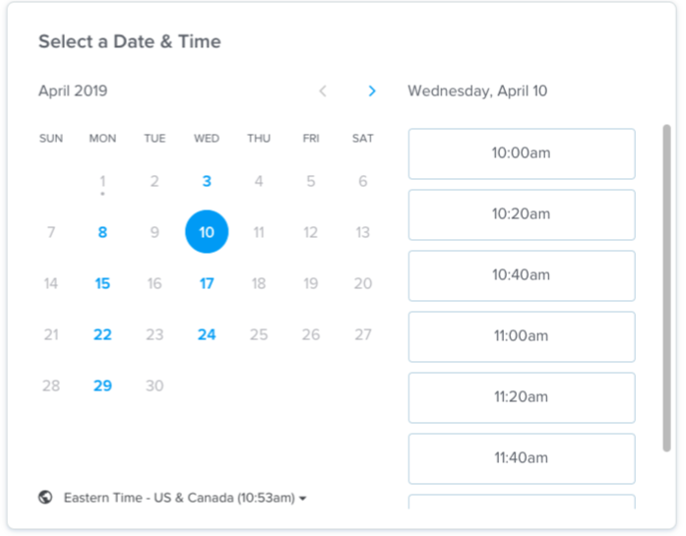
Get Meetings
Matchmaking Service, Meeting Requests
Book a Meeting
Call to action button to book a meeting
Embed personal Calendly
Search attendees by filter to send meeting requests added to their message center

Slide 12
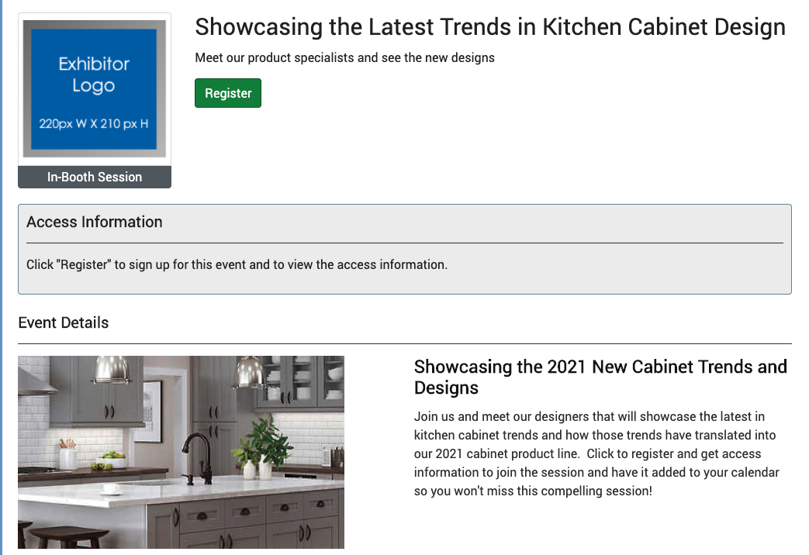
Demo Your Product
Hold In-Booth Sessions
Attendees register capturing contact info
Reminded to attend
Sessions appear in calendar
Sessions appear in site directories

Slide 13
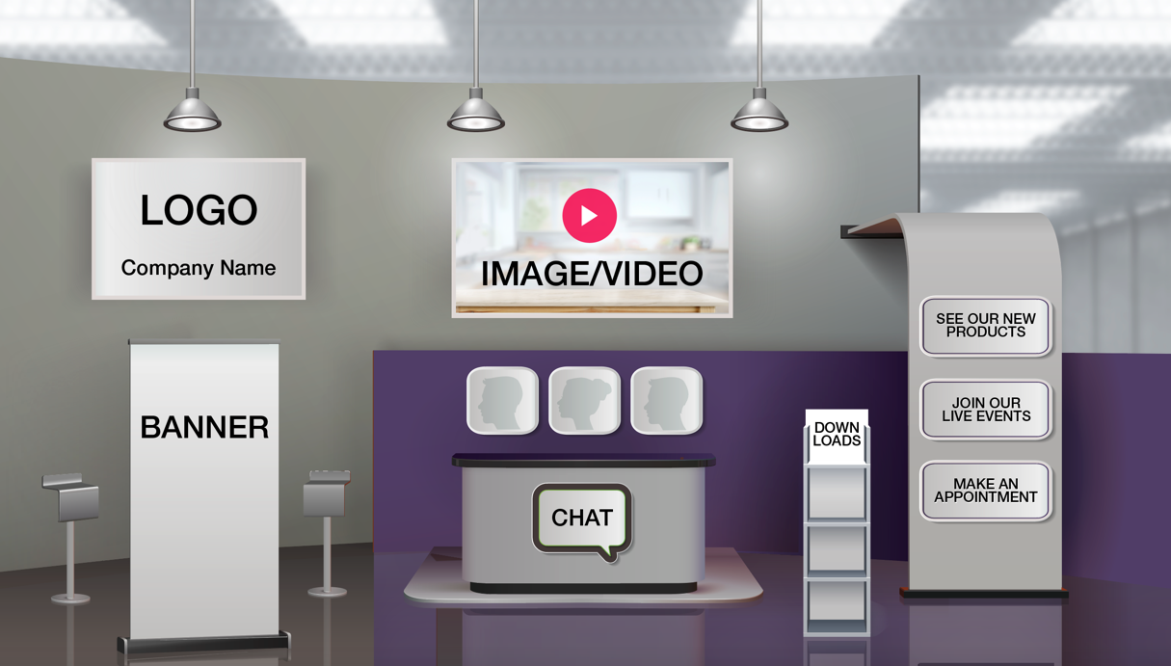
Easy Setup & Onboarding
Plug & Play to Add Materials
Upload graphics you already have
Format is created for you
Video training to make it easy
1 on 1 support available

